Slide 1
Carbon Monitoring and Projection: Permanent Forest Loss
Quan Shen

Slide 2
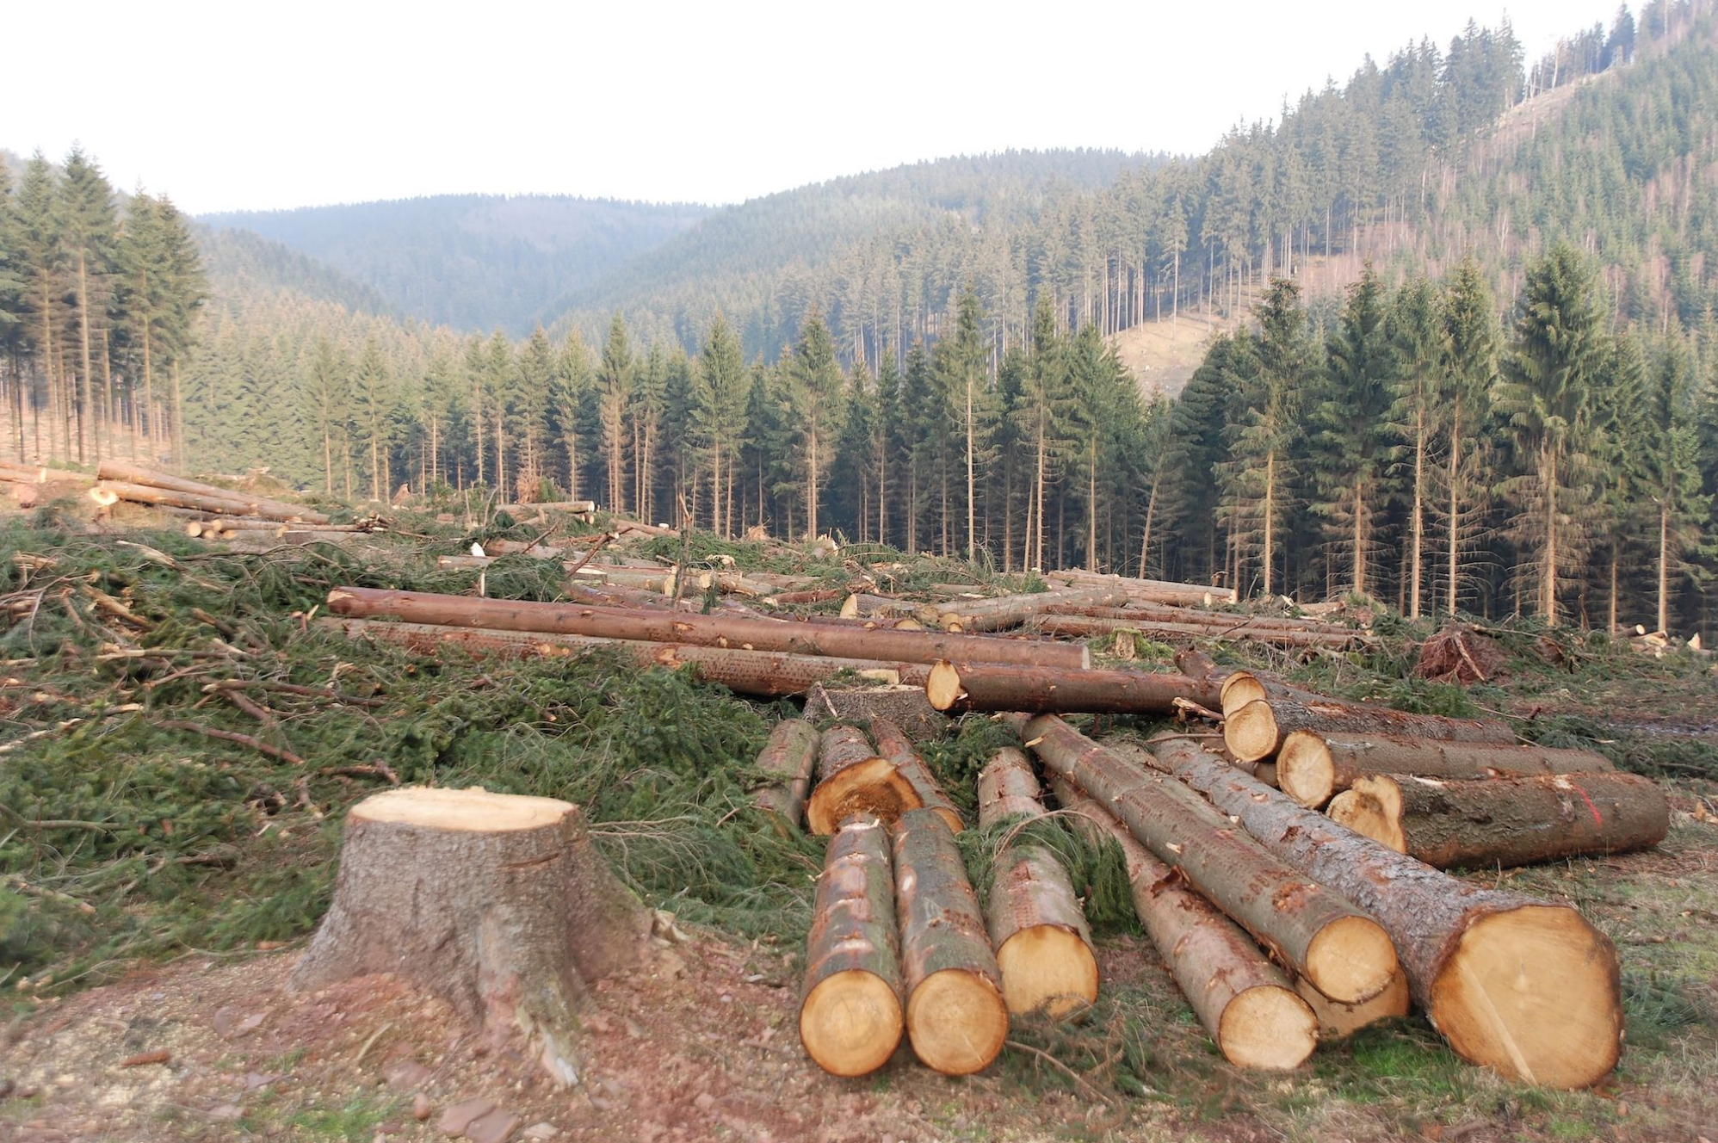
Why carbon? Why forest loss?
Climate change
extreme weather events
the spread of disease
sea level rise
increased food insecurity
Etc.
Carbon sources
Fossil fuels
Deforestation → 20% global anthropogenic CO2 emissions

Slide 3
Problem background
U.S. Climate Alliance – 25 states
Carbon Monitoring System
Use Ecosystem Dynamics (ED) model
Estimate current carbon stock
Project potential carbon stock
Assist government for carbon budget
Detecting and projecting permanent loss improves the accuracy of the ED model results
Better calculate the carbon budget for the state

Slide 4
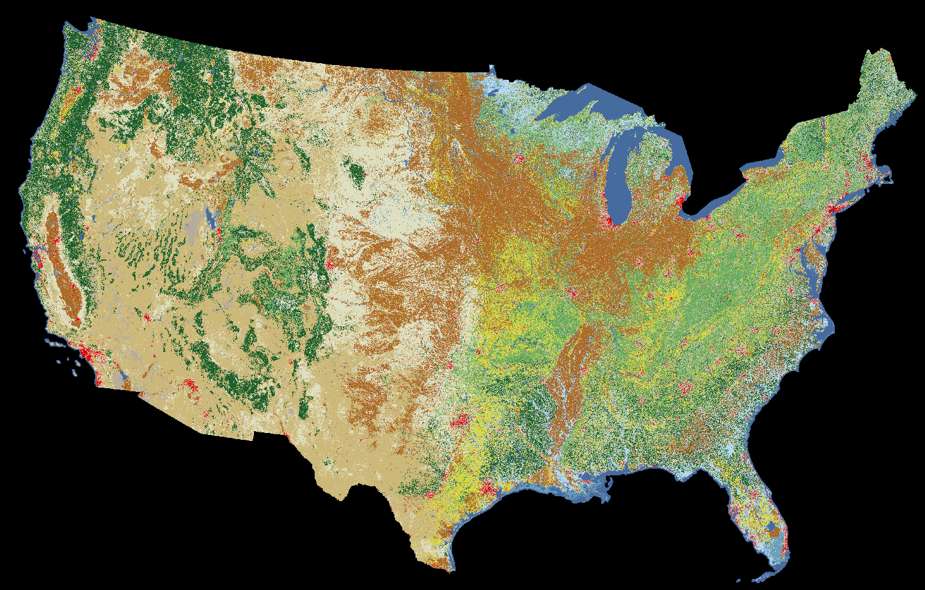
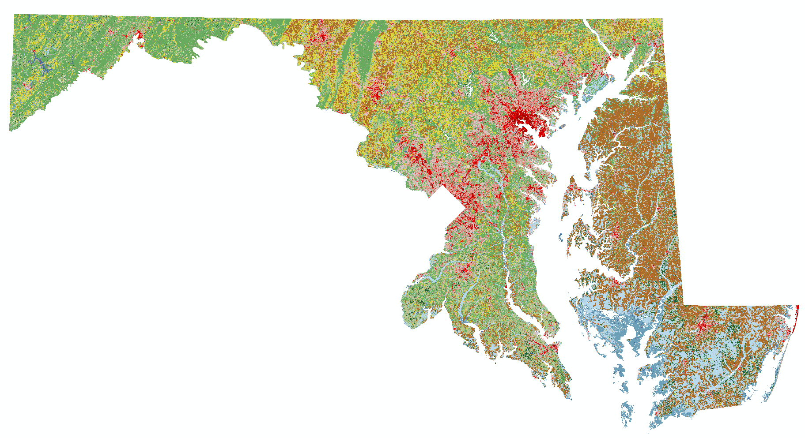
Data
Data source: National Land Cover Database (NLCD)
Data type: raster data
Time period: 2001, 2006, 2011, 2016
Data size: 16.8 GB each
Preprocess: clip and reproject
Study area: Maryland
Limitation of data
The resolution is 30m
Possible misclassification
Forest in the mix pixel might be neglected

Slide 5
Approach
Identify the forest gain sources (non-permanent loss)
Identify the permanent loss of forest
Find the cause of the loss (e.g. to urban)
Using machine learning to project potential permanent loss
Spatial dependence: landcover type nearby, population density, elevation/slope, road network
Validate the result using Global Forest Watch or NLCD 2021
Calculate the commission and omission error

Slide 6
Python packages
Rasterio & Gdal: raster processing
Scikit- learn: machine learning
Pysal: spatial analysis
Scikit-image:

